Slide 1
Trig interpolation
2016-CS-213
2016-CS-222

Slide 2
Agenda
Trig interpolation
Interpolation of trigonometric polynomials is known as trigonometric Interpolation. By using interpolation methods we can find a function which is covered by some data points. The requirement of trigonometric interpolation is that the function used in this process must be a trigonometric polynomial.

Slide 3
Methodology
Fourier Series
THE FOURIER TRANSFORM
BASEL Problem
Heat Equation
Fast Fourier Series
Single Dimension Fast Fourier Transform
Multi Dimension Fast Fourier Transform

Slide 4


Methodology
Lagrange Formula for Polynomial Interpolation
Odd number of points
Even number of points
Trigonometric Interpolation for Periodic Function
Fourier Series

Slide 5
Comparison
Fourier Series | Fourier Transform
It is for periodic signals. | It is for aperiodic signal.
It is used to decompose signals in complex exponential. | It is used to analyse signals in other domain.
Non–periodic function is not applicable. | It converts non-periodic function into continuous frequency domain.
Fourier series states that, periodic signals can be represented into sum of sines and cosines. | Fourier transform states that the non-periodic signals whose area under the curve is finite can also be represented into integrals of sines and cosines after being multiplied by a certain weight.

Slide 6
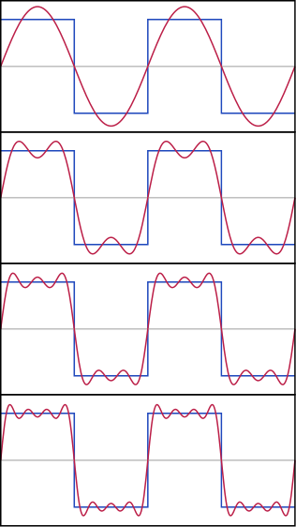
Error Analysis
Error of Trig Interpolation
Algebraic Convergence
Exponential Convergence
Error In Fast Fourier Transform(FFT)
Round off Error
Amplitude Error
Error In Fourier Series
Mean Squared Error
Truncation Error

Slide 7
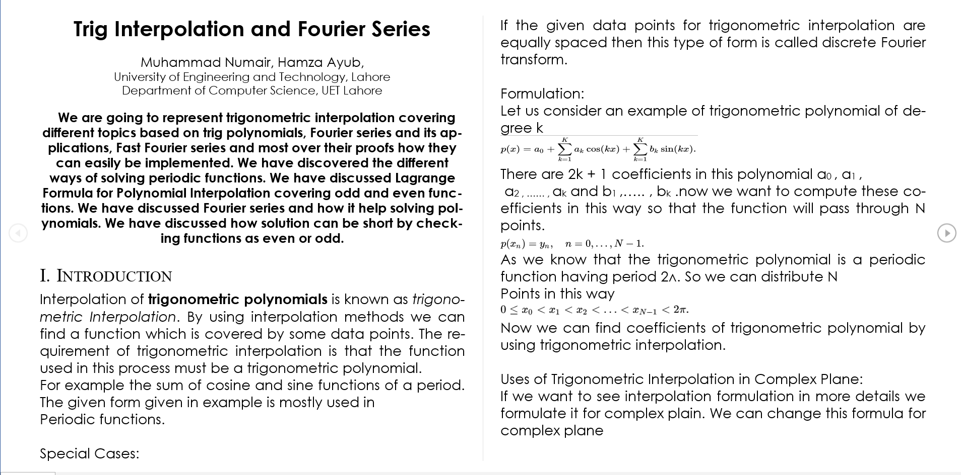
Report Demo

Slide 8
Queries?
If you have any queries feel free to ask…

